Slide 1
Analyzing Visual World Eye-tacking Data: A Hands-on Introduction
Yuhang Xu/徐雨航
University of Rochester
yuhang.xu@rochester.edu

Slide 2
Plan
2:30-3:20 “Getting the data”
3:20-3:30 Break
3:30-4:30 “Analyzing the data ”
4:30-5:00 Q & A

Slide 3
Qs you may have…
Do I really need to use VWP?
For example, the VWP cannot be used for the study of
(a) language that is not at least partially about the visual world;
(b) language that is about events and entities that cannot easily be depicted
(c) written language. (reading…)
Salverda, A.P., & Tanenhaus, M.K. (in press). The visual world paradigm. In A.M.B. de Groot & P. Hagoort (Eds.), Research methods in psycholinguistics: A practical guide. Malden, MA: Wiley-Blackwell.
But…

Slide 4
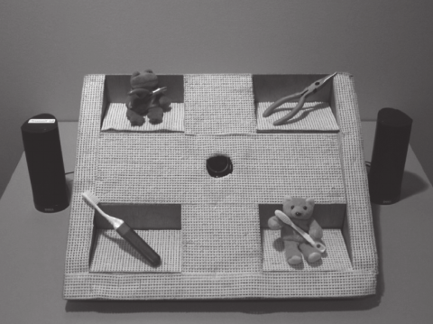
Qs you may have…
I don’t have a fancy eye-tracker…
I do field work…
Figure . A set-up for the ‘Poor Man’s’ eye-tracker Pozzan and Trueswell

Slide 5
Qs you may have…
Why do we need to cover both “experiment programming” and “data analysis”
Examples:

Slide 6
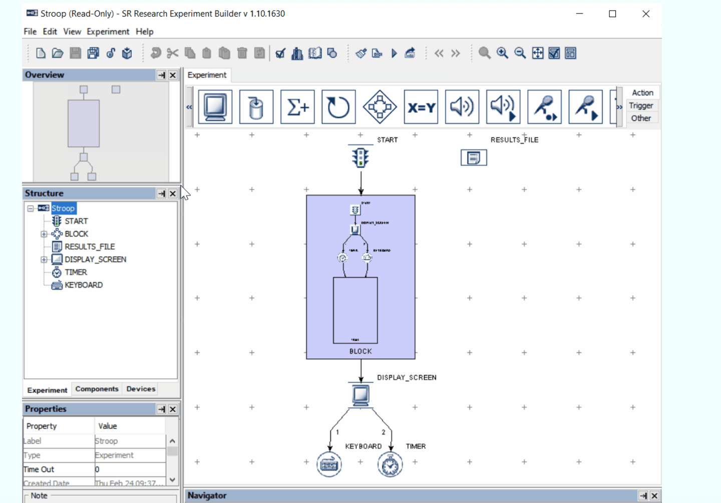
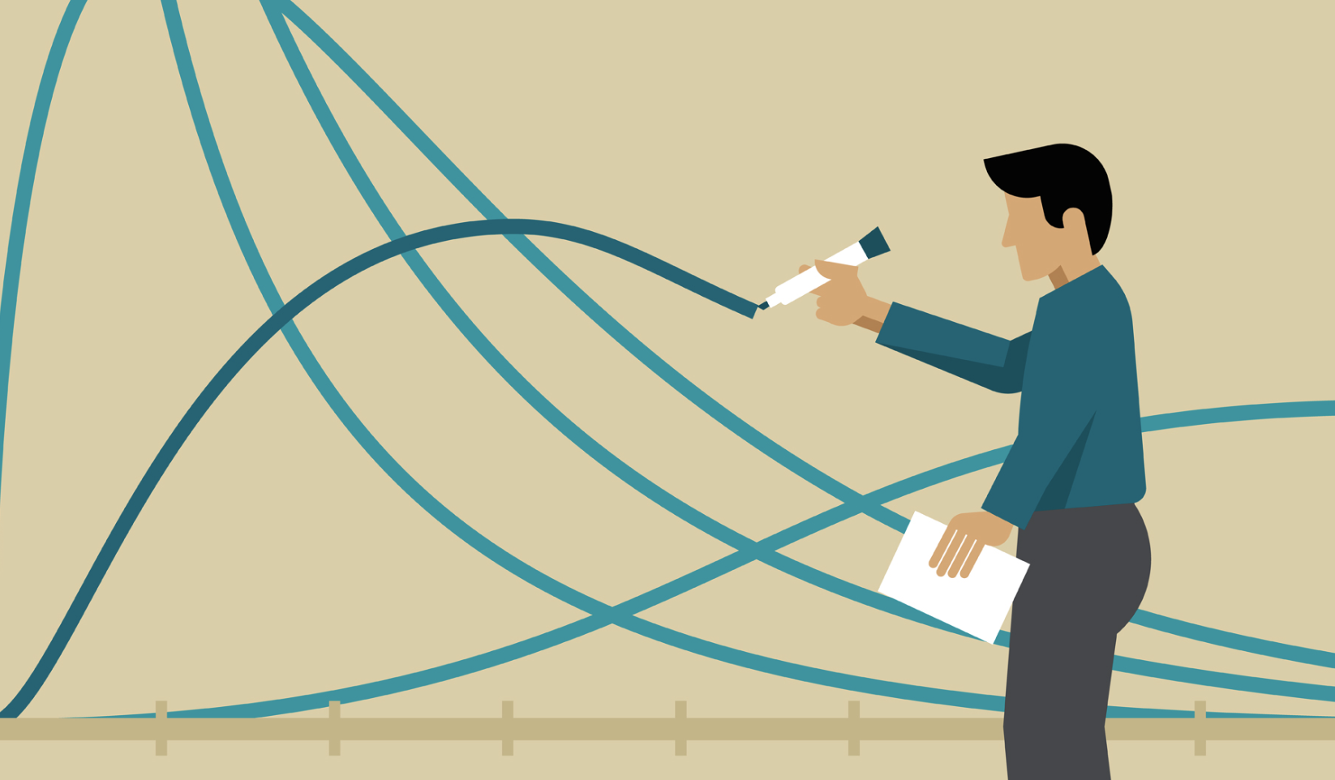
Example:
When Implementing an visual world experiment using popular Experiment Builder…
What to include?

Slide 7
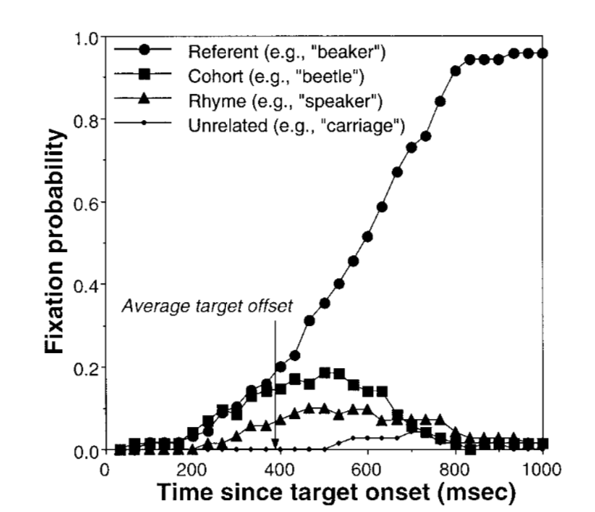
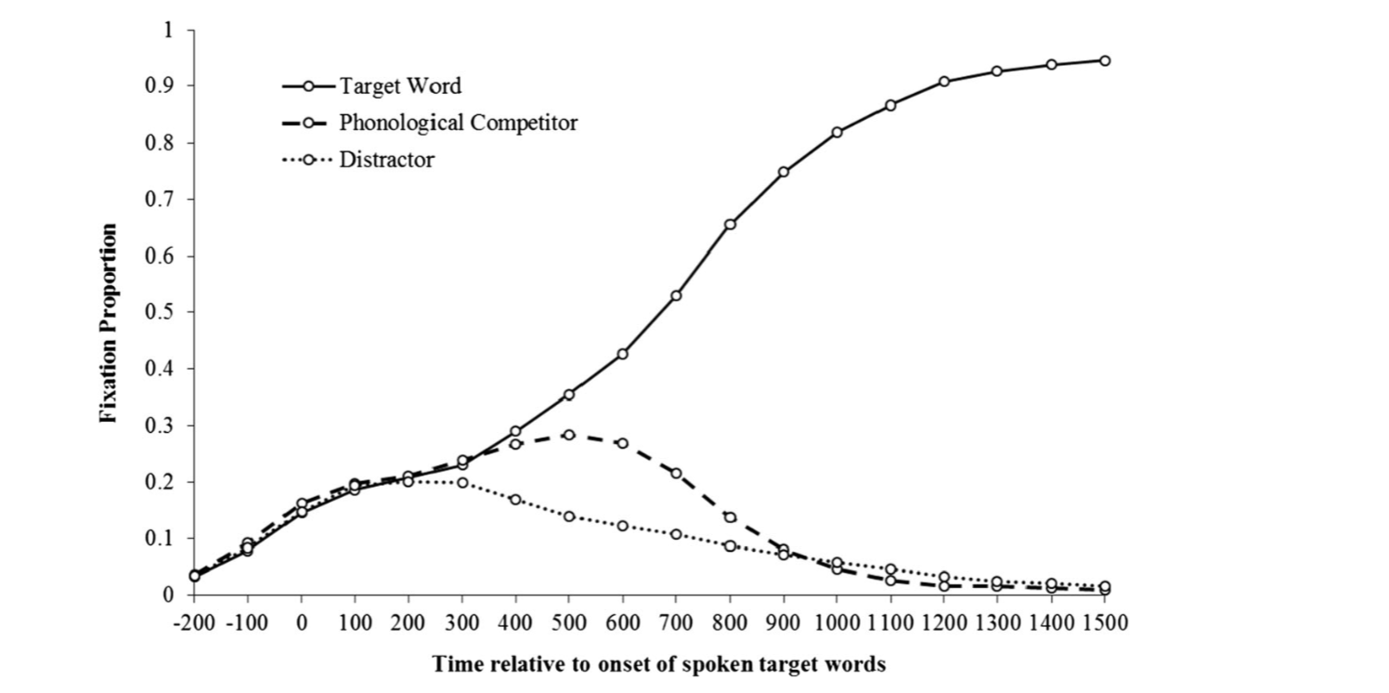
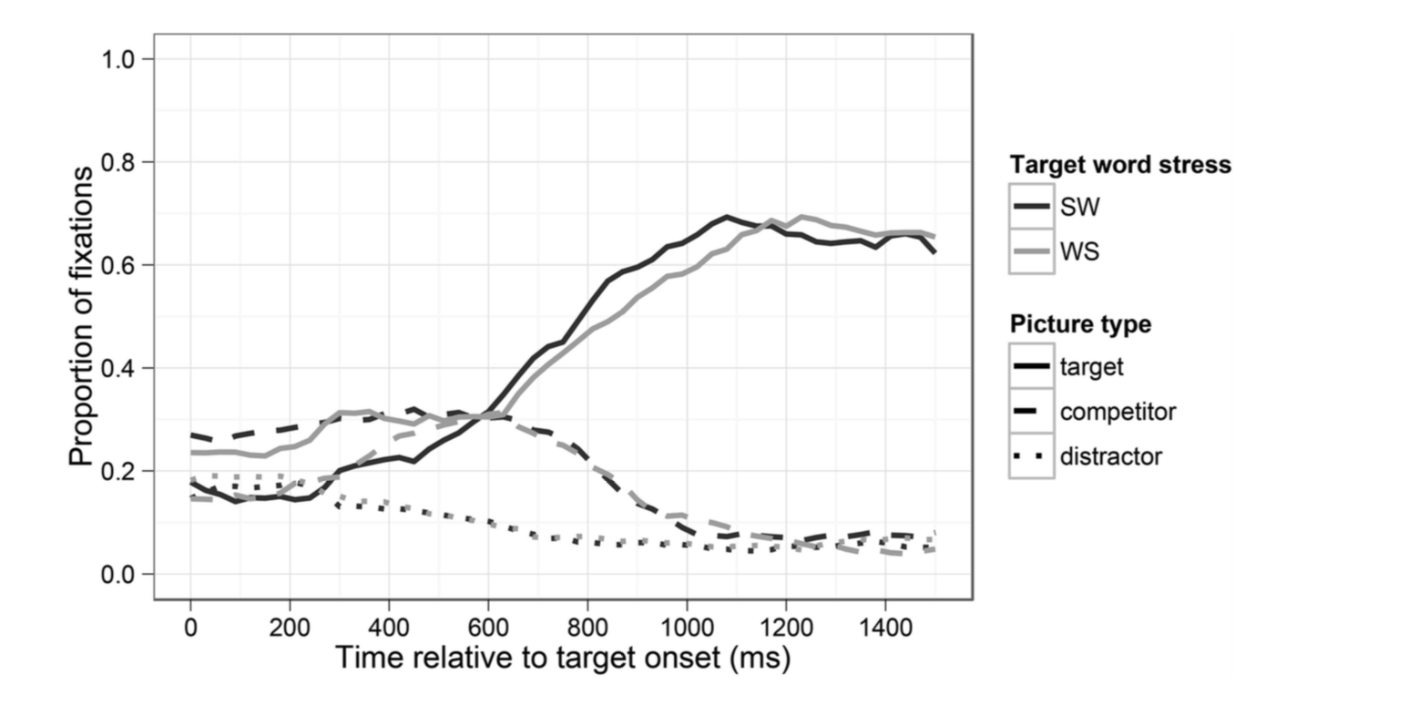
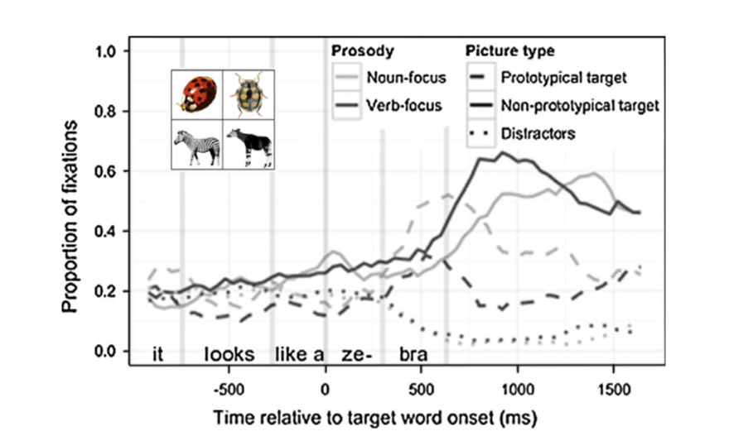
Example : “+”

Slide 8
Example : “+”
“Unless there are other compelling reasons, we recommend against instructing participants to fixate a specific location at the start of a trial (e.g. by using a fixation cross). Maintaining fixation is resource-intensive. Moreover, asking participants to control their initial fixation can reduce the number of eye movements, with some participants maintaining fixation until before they begin to perform an action.”

Slide 9



Style of this tutorial
Two extremes…
yuhang.xu@rochester.edu

Slide 10
Part 1
Getting the data

Slide 12
Software
Experiment Builder 💓
SR-Research ”build-in” with the eyelink eye-tracker
Eyelink+EB
MATLAB
MATLAB along with the Psychophysics Toolbox
http://sarahbrownschmidt.com/lab/
Sarah Brown-Schmid. Vanderbilt University.
Eyelink+ MATLAB
E-Prime
The University of Tokyo
伊藤たかね & 陳姿因
Tobi+E-Prime
Other software with other eye-trackers?
SMI?

Slide 13
Experiment Builder
Workflow
Components
Useful tips

Slide 14
SR Research Support
Main web site: https://www.sr-research.com
Support Forum: https://www.sr-support.com/forum
You'll need to create an account.

Slide 15
Experiment Builder
A graphical programming environment for building experiments.
Conceptually similar to E-Prime.
Tightly integrated with Eyelink eye trackers.
Files->Examples
EB Project Checklist
Chapter 16 of Experiment Builder User Manual
Read it. Follow it.

Slide 16
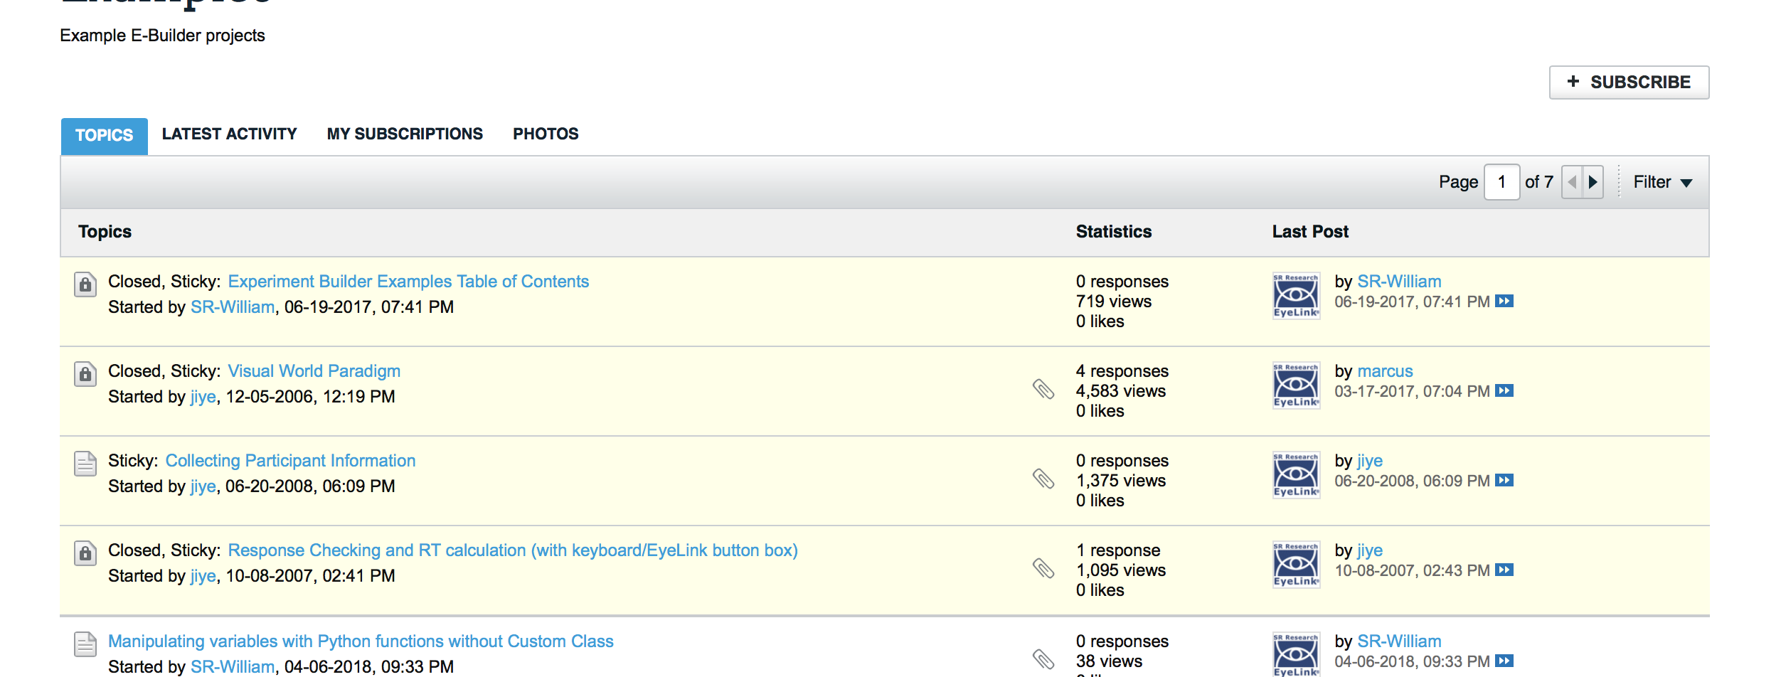
Experiment Builder
Demo
https://www.sr-support.com/forums/
VWP Template

Slide 17
Experiment Builder
Let’s go to the Experiment Builder
Listen carefully…
No notes on this part…

Slide 18
Next,
Extracting relevant sample reports from raw eye-tracking data

Slide 19
Data Viewer
“sample report”

Slide 20
Part 2
Analyzing the data

Slide 21
Motivation for mixed effects models
Problems with ANOVA
Multiple random effects (subjects, items)
Categorical outcomes
Continuous predictors

Slide 22

Motivation for mixed effects models
Inferential statistics you may be familiar with:
ANOVA • Regression • Correlation
All of these methods involve random sampling out of a larger population

Slide 23
Motivation for mixed effects models
Standard assumption: All observations are independent
• Subject 1’s score doesn’t tell Subject 1 us anything Subject 2 about Subject 2’s
Independence assumption is fair if we randomly sample 1 person at a time
e.g., you recruit 100 undergrads from the NJUST Subject Pool
But many research designs involve more complex sampling procedures

Slide 24
NJUST
NUU
NJU
Year1
…
Year1
…
Year1
…
P1
P2
P1
P2
One way to describe what’s going on here is that there are several levels of sampling, each nested inside each other

Slide 25
Nested Random Effects
Two challenges:
Statistically, we need to take account for this non independence (similarity)
Even a small amount of non-independence can lead to spurious findings (Quené & van den Bergh, 2008
We might want to characterize differences at each level!

Slide 26
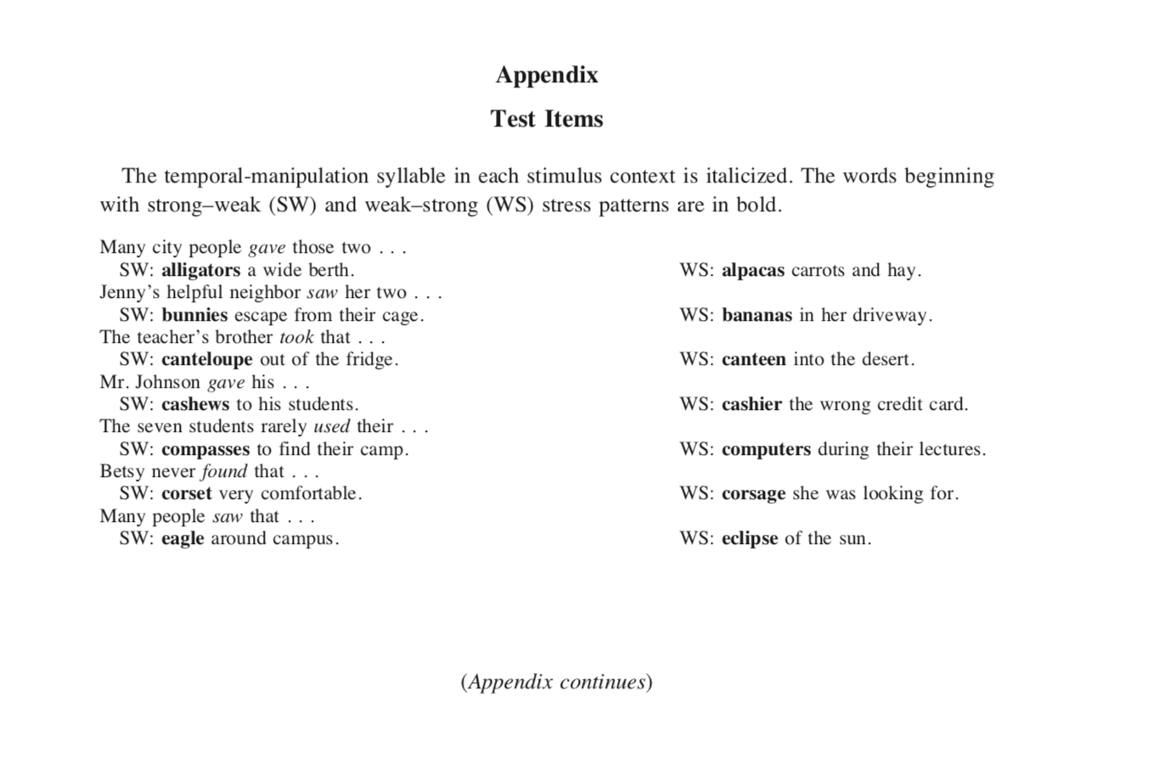
Crossed Random Effects
Items you used
Experimental / research materials are often sampled out of population

Slide 27




Crossed Random Effects
we are sampling two things—subjects and items
arrangement is slightly different because each subject gets each item
Crossed random effects
Still, problem is that we have multiple random effects (things being sampled)

Slide 28
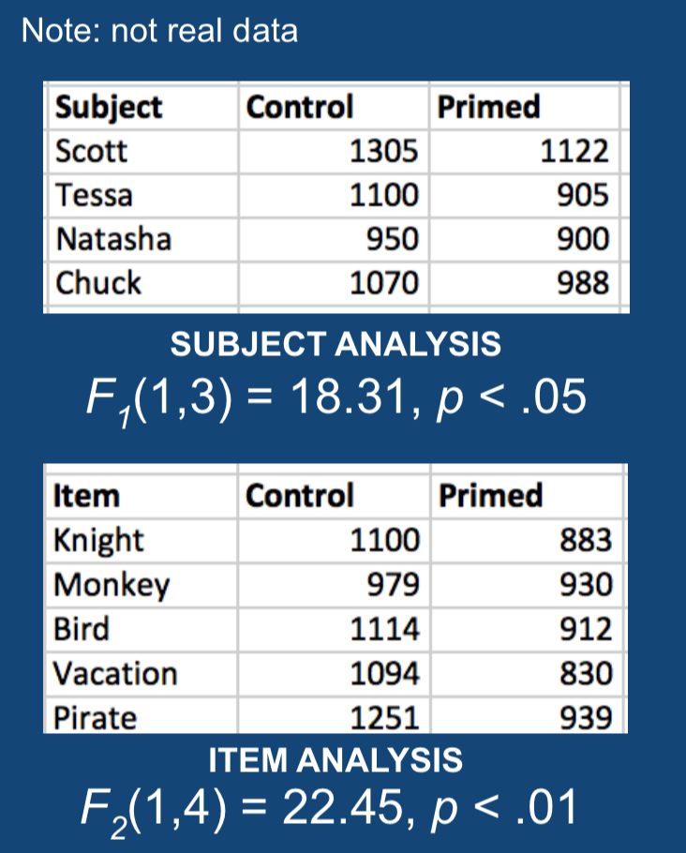
OLD ANOVA solution: Do 2 analyses
F1 F2
Subjects analysis:
Compare each subject (averaging over all of the items)
Does the effect generalize across subjects?
Items analysis:
Compare each item (averaging over all of the subjects)
Does the effect generalize across items?
Problem: We now have 2 different sets of results.
Might conflict!
Possible to combine them with min F’, but not widely used

Slide 29




Problem 2: Categorical Data
ANOVA assumes our response is continuous
E.g., RT= 2890ms
But, we often want to look at categorical data

Slide 30
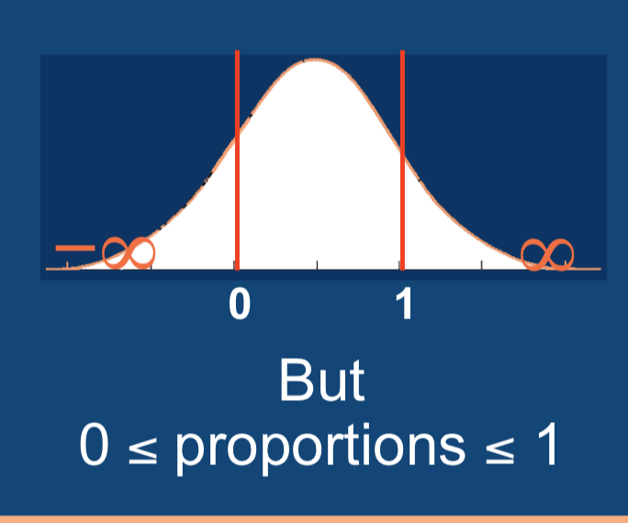
Problem 2: Categorical Data
Analyze proportions
Maybe with some transformation
(e.g., arcsine, logit)
Violates assumptions of ANOVA
ANOVA assumes normal distribution, which has infinite tails
But proportions are clearly bounded
Model could predict impossible values like 150%
Can lead to:
- Spurious effects
(Type I error)
- Missing a true effect
(Type II error)

Slide 31
Problem 3: Continuous Predictors
Many interesting independent variables vary continuously
e.g., Word frequency; Second language proficiency; reading skill; SAT scores
ANOVAs require division into categories
e.g., median split
Problem:
Can only ask “is there a difference?”, not form of relationship
Loss of statistical power (Cohen, 1983)

Slide 32
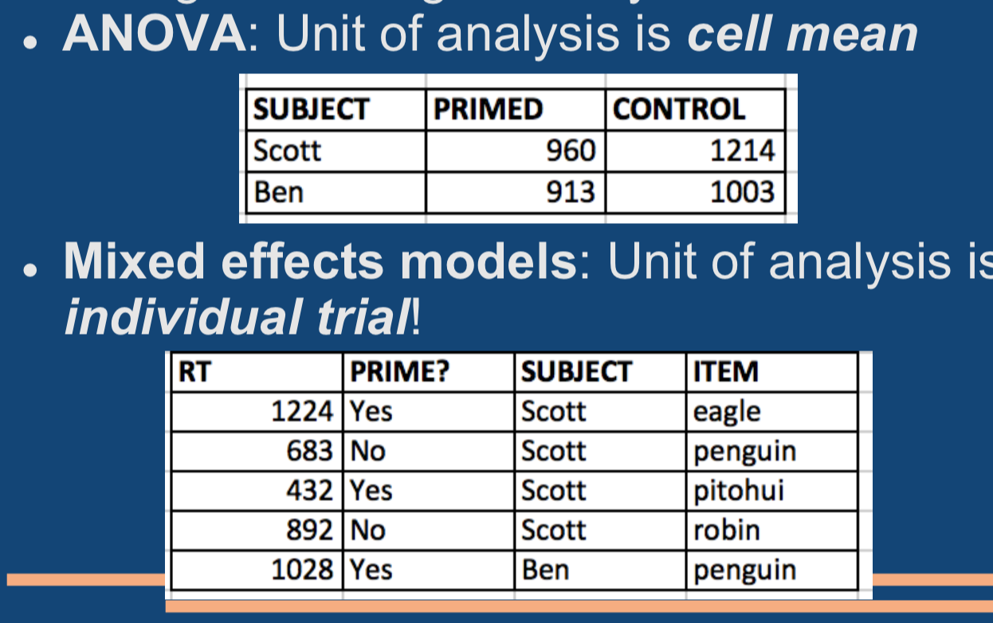
Mixed Effects Models to the Rescue!
Biggest contribution of mixed-effects models is to incorporate multiple random effects into the same analysis

Slide 33
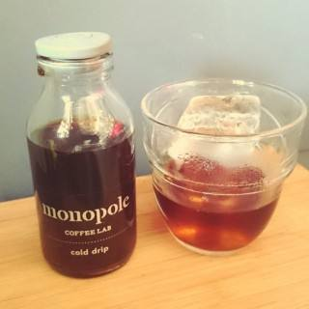





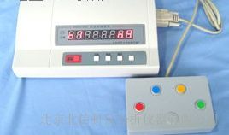
Mixed Effects Models
Model outcome using regression-like approach
Look at individual trials/observations (not means)
In a regression, easy to include independent variables that are continuous
Link functions allow us to relate model to DV that isn’t normally distributed
lmer( RT ~ Class+Frequency + (1|Subject) + (1|Item), lexdec )
Fixed effects
Random
Y

Slide 34
How about VWP data
outcome
0,1 look or not
Predictor
Time-window
Continuous OR Categorical

Slide 35
eyetrackingR
eyetrackingR was created by Jacob Dink and Brock Ferguson. Jacob and Brock received their PhD's in Cognitive Science from Northwestern University and are now co-founders of Strong Analytics, a data science consulting and development firm.
Each eyetrackingR vignette uses the eyetrackingR package to analyze real data from a simple 2-alternative forced choice (2AFC) word recognition task administered to 19- and 24-month-olds. On each trial, infants were shown a picture of an animate object (e.g., a horse) and an inanimate object (e.g., a spoon). After inspecting the images, they disappeared and they heard a label referring to one of them (e.g., “The horse is nearby!”). Finally, the objects re-appeared on the screen and they were prompted to look at the target (e.g., “Look at the horse!”).

Slide 36
eyetrackingR-Demo

Slide 37
Q & A
yuhang.xu@rochester.edu

